Slide 1

AMAZON SALES
DATA ANALYSIS REPORT
CHANDAN BHATTACHARYA

Slide 2

Introduction
Offering millions of products for online purchase, Amazon is a global leader in e-commerce. Beyond just retail, it now offers cloud computing services and creates smart home appliances.
The relevance of sales management has increased in response to the growing competition and the demand for better distribution strategies that lower costs and boost profitability.
The sales trend for each month-wise, year-wise, and yearly-month-wise is included in this project, along with important metrics and elements that highlight the significant connections between the various features.

Slide 3
Main KPIs
Total Revenue by Year.
Total Profit by Year.
Total Cost by Year.
Total Units Sold by Year.
Profit Distribution.
Last Year Revenue.

Slide 4
Proposed Work
Data Cleaning: Made a few small changes to improve the cleanliness of the data. fixed inconsistencies in date formatting by using fundamental Excel features.
Data processing: To increase data integrity, columns in the Excel sheet were reorganized and adjusted, and any null entries were removed.
Data Analysis: To reveal insightful information, key performance indicators (KPIs) were extracted from the Excel dataset.
Data Visualization/Dashboard Creation: Made use of Microsoft Power BI to produce eye-catching data visualizations that make thorough data analysis and decision-making easier.

Slide 5

Output Results From Dashboard

Slide 6
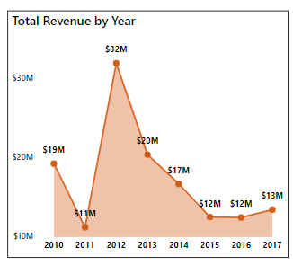
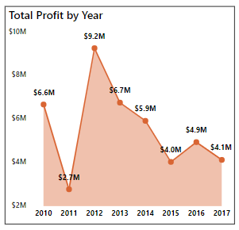
Total Revenue by Year
Total Profit by Year

Slide 7
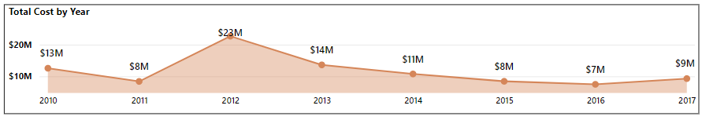
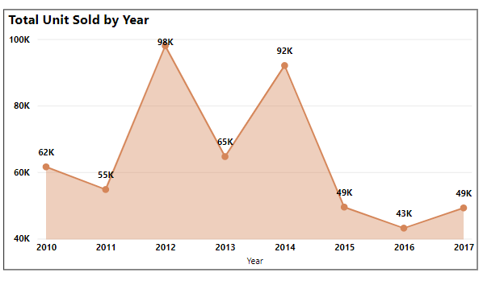
Total Cost by Year
Total Unit Sold by Year

Slide 8
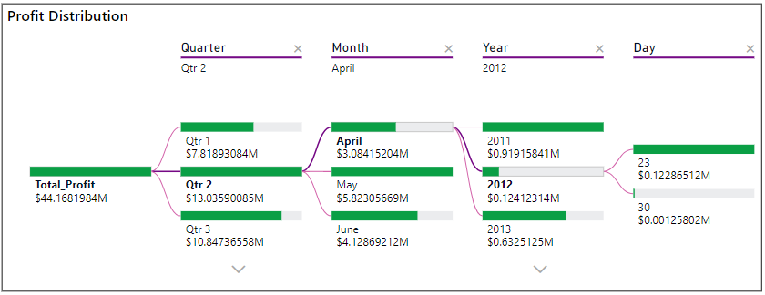
Profit Distribution

Slide 9
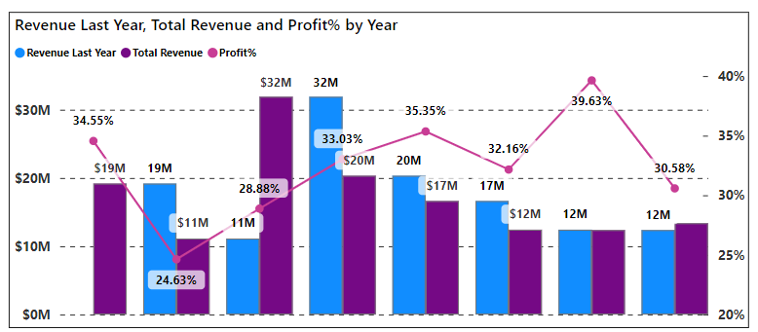
Last Year Revenue

Slide 10
Data Insights
Trends in Monthly Sales:
With $24,740,517.77 in sales, February (Month 2) had the Highest.
August's (Month 8) Lowest sales amount was $1,128,164.91.
There are seasonal fluctuations in sales.
Trends in Yearly Sales:
$31,898,644.52 was the highest sales amount in 2012.
$12,427,982.86, the lowest sales in 2015.
Yearly sales generally follow a cyclical trend.

Slide 11
Data Insights
According to my analysis, there was a total revenue of $137.35 million, a total profit of $44.17 million, and a total cost of $93.18 million. The computed average profit margin and unit price are $32.16 and $276.76, respectively.
"Cosmetics" was the best-selling product category, and "Fruits" had the lowest sales.
Notably, with $31.90 million in sales revenue, 2012 was the biggest year.
Sales in the Sub-Saharan Africa area reached a peak of $39.67 million, with the "Office Supplies" category accounting for almost $10.5 million of that total. This suggests a chance to grow business in underserved Sub-Saharan Africa, especially for "Office Supplies."

Slide 12
Thank You

